Slide 1
OBJECTIVE
The goal of this Tableau project is to analyse financial performance across different countries, products, and time periods, using key financial metrics such as sales, profit, cost of goods sold (COGS), and discounts.
Columns Provided:
● Segment, Country, Product, Discount Band, Units Sold, Manufacturing Price, Sale Price, Gross Sales, Discounts, Sales , COGS(Cost of Goods Sold), Profit, Date, Month Number, Month Name, Year.

Slide 2
DATA DESCRIPTION
Segment: Categorizes the customers into different groups (e.g., Government, Enterprise, Small Business).
Country: Specifies the country where the sales occurred.
Product: Identifies the specific product sold.
Discount Band: Indicates the level of discount applied to the product (e.g. High, Low, Medium, None).
Units Sold: Represents the number of units of the product sold.
Manufacturing Price: The cost of producing a single unit of the product.
Sale Price: The price at which the product is sold to the customer.
Gross Sales: The total revenue generated from sales before any discounts are applied (Units Sold * Sale Price).
Discounts: The total amount of discounts given on the product sales.
Sales: The net revenue after applying discounts (Gross Sales - Discounts).
COGS: The total cost of goods sold for the products (Units Sold * Manufacturing Price). Profit: The net profit from the sales. Date: The date of the sale transaction.

Slide 3
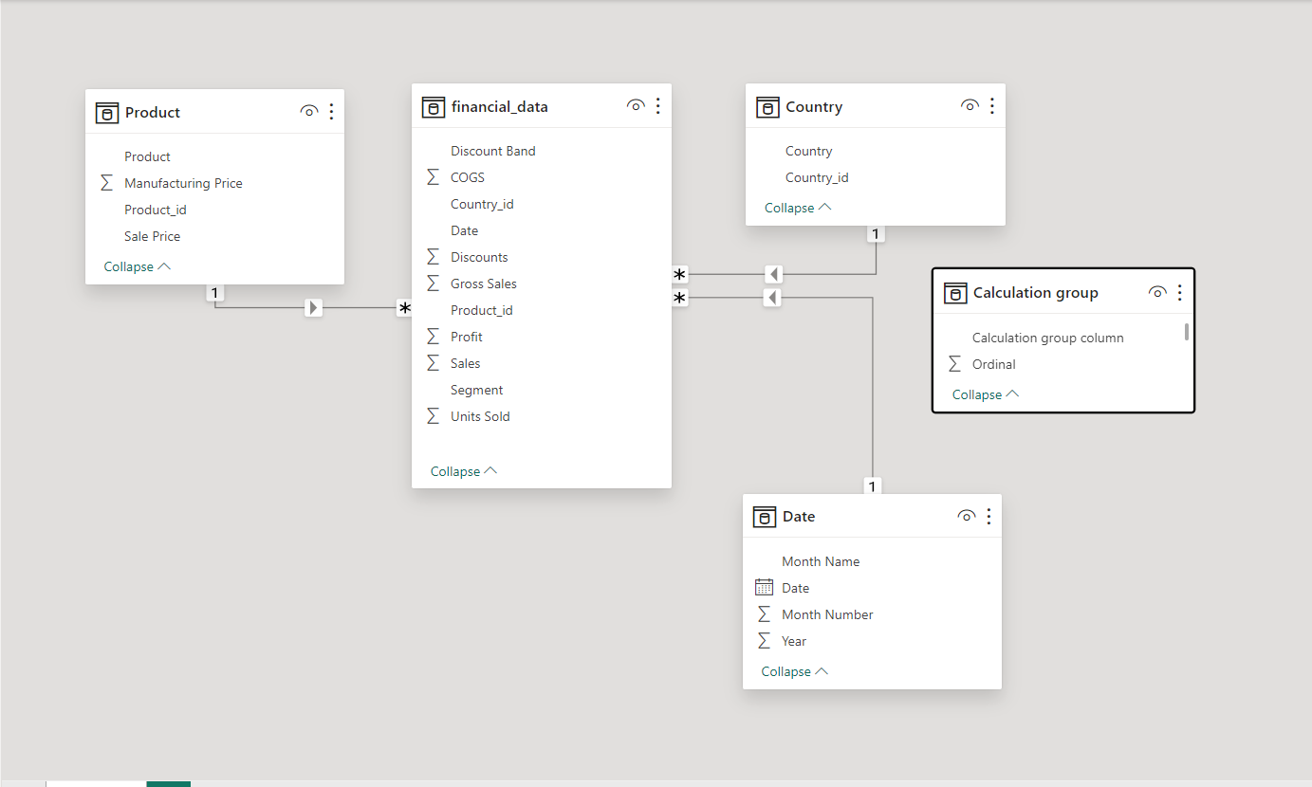
DATA MODEL

Slide 4
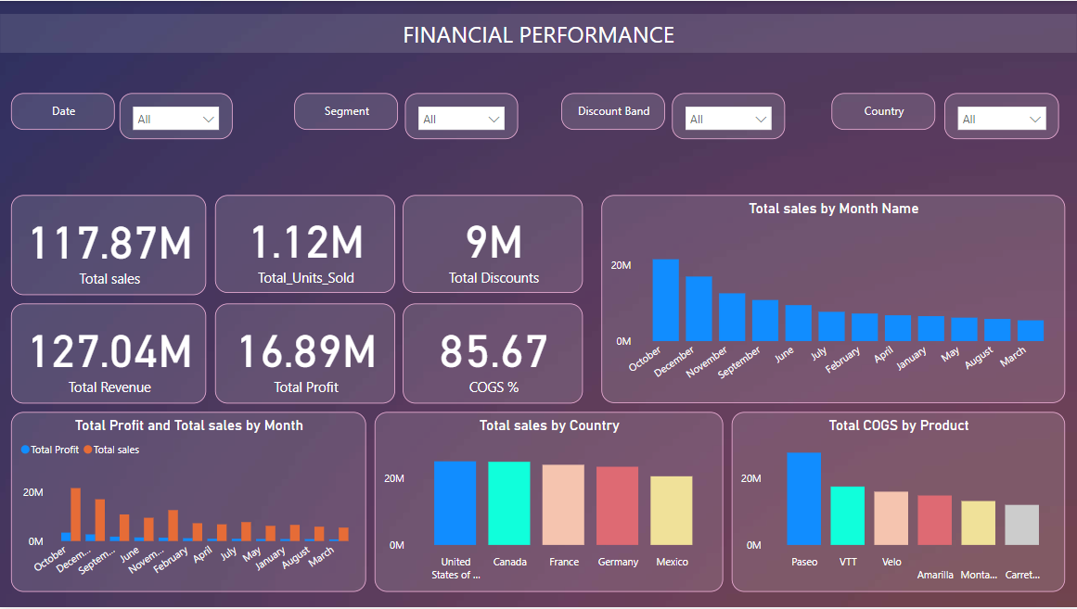
Dashboard

Slide 5
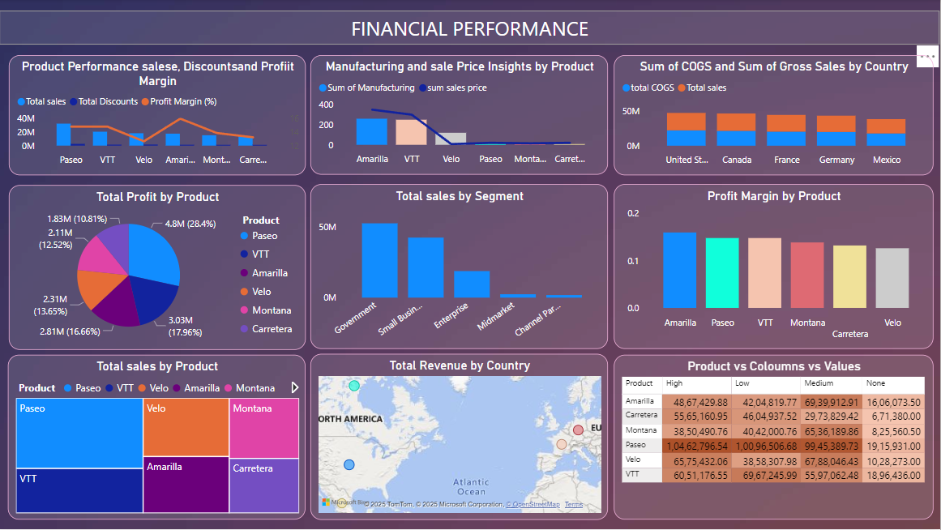
Dashboard

Slide 6
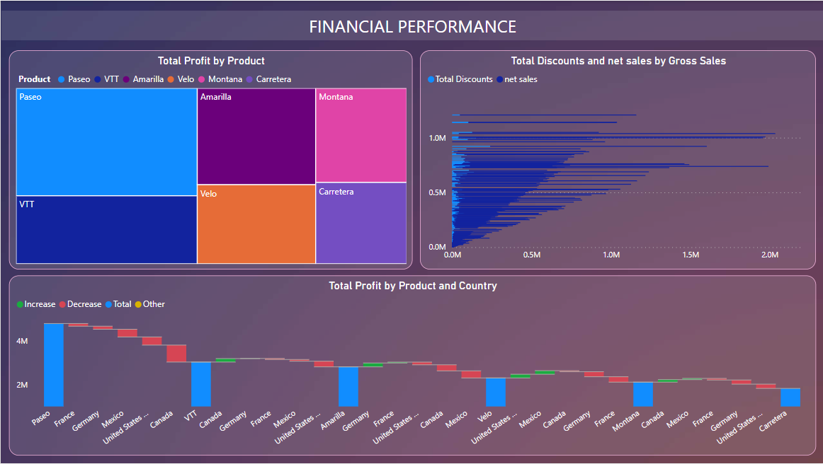
Dashboard

Slide 7
Key Insights
There are months with significantly higher sales and profit compared to others. This suggests that the business is likely impacted by seasonal factors such as weather, holidays, or consumer.
Generally, a positive correlation exists between sales and profit. As sales increase, profit tends to increase as well. However, there are exceptions where high sales do not translate into proportionally high profits, indicating potential cost pressures or pricing challenges.
COGS generally increase with sales, which is expected as higher sales volumes typically require higher production or procurement costs. However, the relationship between sales and COGS is not always linear, suggesting variations in production efficiency or input costs across different months.
Profit margins fluctuate throughout the year. Some months demonstrate higher profit margins compared to others, indicating variations in pricing strategies, cost control measures, or market conditions.

Slide 8
Recommendations
The company should analyse months with higher sales (December, November and October) to understand the underlying factors driving these peaks (e.g., seasonal demand, marketing campaigns, promotions). This knowledge can be used to strategically plan inventory, staffing, and marketing efforts in future peak months.
While higher sales are desirable, it's crucial to manage costs effectively during peak periods. The company should explore ways to optimize COGS, such as negotiating better deals with suppliers, streamlining production processes, or minimizing waste.
To maintain a consistent revenue stream, the company should consider implementing targeted marketing campaigns during months with lower sales to stimulate demand.

